Slide 1
Classroom Assignment
Terp Talent Advantage Program
Date: 07/01/2024

Slide 2
Executive summary
Classroom scheduling is a complex task in educational institutes worldwide. To address this for the Smith school of Business, we developed an optimization model using IBM CPLEX, informed by multiple discussions and paper references.
Maximizes professor timeslot preferences
Rewards consecutive classes
Incorporates constraints like classroom capacity, specific class assignments, and mutual exclusivity of courses
Ensures professors teach only their assigned courses and are not scheduled in multiple classrooms simultaneously
This model enhances scheduling efficiency and satisfaction, streamlining the process effectively.

Slide 3
Problem Definition
Allocating classrooms to courses at the Smith School poses a significant challenge each semester. This process is time-consuming and often involves conflicts in scheduling. Each classroom varies in capacity and features, while courses have diverse enrollment and specific requirements. Faculty members also express preferences for particular classrooms and time slots.

Slide 4
Objective and Goal
Develop an effective scheduling system using IBM CPLEX for Smith School that accomplishes the following goals:
Satisfies Classroom Capacity: Ensures that the number of students enrolled in each course does not exceed the capacity of the assigned classroom.
Meets Course Requirements: Assigns each course the specified number of times it needs to be taught.
Avoids Conflicts: Prevents scheduling conflicts where multiple courses or professors are assigned to the same classroom and timeslot.
Adheres to Professor Assignments: Ensures that only the designated professors are assigned to teach their respective courses.
Respects Professor Preferences: Maximizes the alignment of the schedule with the professors' preferred time slots and days, considering their availability and willingness to teach at specific times.

Slide 5

Journey
Project Kick off
Refining prototype
Scope defined
Build a prototype
Project presentation and discussion
Research and information gathering
Based on prior discussions, we prioritized professor preferences and incorporated scheduling across different days of the week.
Problem defined and developed a quick design
Built models in cplex for multiple scenarios
Week 1
Week 2
Week 3
Week 4
Week 5
Week 6

Slide 6
Model Walkthrough

Slide 7
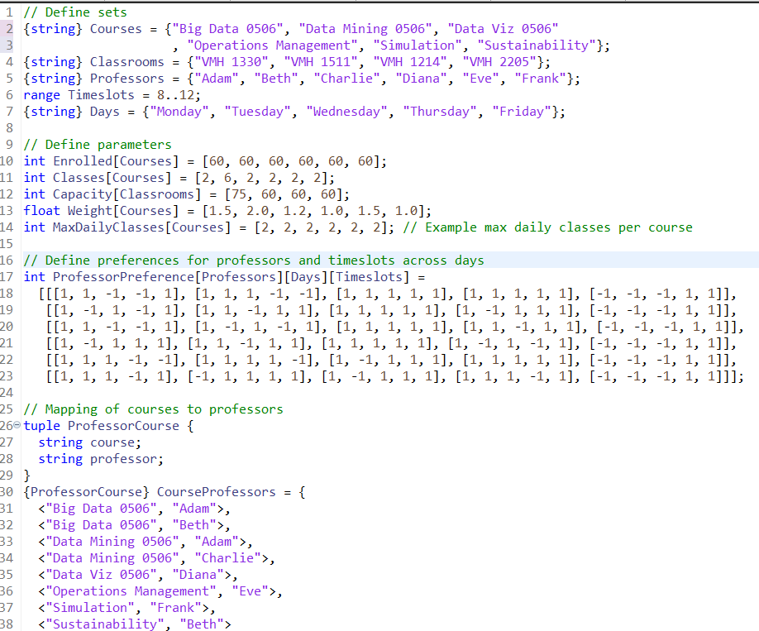
Data and Parameters
Data used
C: Set of courses
R: Set of classrooms
P: Set of professors
T: Set of time slot
D: Set of days
Parameters
𝐸c: Number of students enrolled in course c∈C
Lc: Number of classes required for course c∈C
𝐾r: Capacity of classroom r∈R
𝑀c: Maximum number of classes for course c∈C per day
ProfPrefp𝑑𝑡​: Preference of professor p∈P for teaching at time slot t∈T on day d∈D
𝑊𝑐: Weight of course c∈C
CourseProf𝑐: Set of professors who can teach course 𝑐∈𝐶

Slide 8
Decision Variables and Objective function
Decision Variables
x_{c,r,t,d,p}​: Binary variable that is 1 if course c is scheduled in classroom r at time slot t on day d and taught by professor p, 0 otherwise
y_{c,d,t}​: Binary variable that is 1 if course c is scheduled at time slot t on day d, 0 otherwise
Objective function
Maximize the sum of weighted preferences plus a bonus for consecutive classes:
Max∑_{c∈C}∑_{r∈R}∑_{t∈T}∑_{d∈D}∑_{p∈P}(W_{c} * ProfPref_{p,d,t} * x_{c,r,t,d,p})+∑_{c∈C}∑_{d∈D}∑_{t∈T:t<21}y_{c,d,t}

Slide 9
Constraints
Subject to:
Ensure that the enrolled students does not exceed the classroom capacity.
Each course needs to be assigned exactly the number of times specified.
Each classroom is used at most once per time slot.
Each professor can teach only one course in one classroom at one time slot.
Ensure a professor teaches only their assigned courses.
Daily Class Limit: Each subject can be scheduled only up to its specified maximum times per day.
*Professor Preferences: Ensure a professor teaches only their assigned courses according to their preferences.
*Consecutive Classes Constraint: Ensure that no course is scheduled in consecutive time slots.

Slide 10
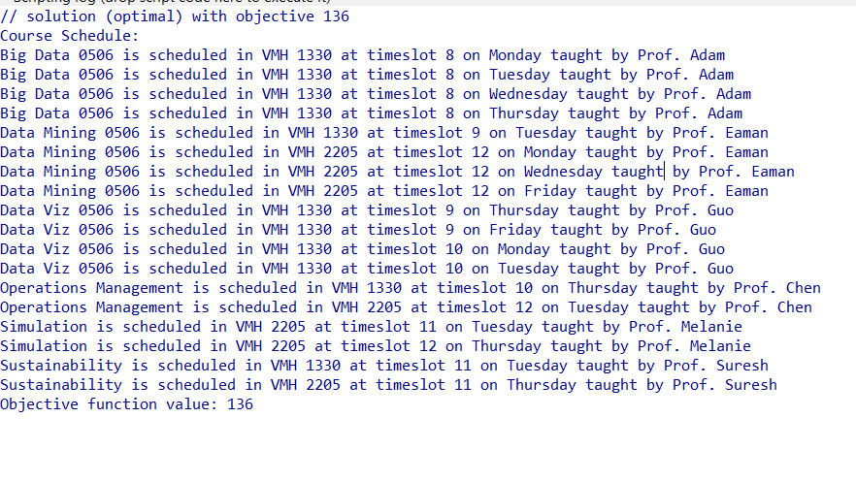
Schedule creation

Slide 11

Way forward
While developing the current model, several additional considerations emerged that were not included:
Courses with varying durations.
Courses with online and offline schedules.
Courses requiring specific resources such as audiovisual equipment.
Faculty engagements in other schools and its impact on scheduling.
The need to minimize the number of classroom days or gaps between classes.

Slide 12
Thanks!
Questions?
Please keep this slide for attribution

